Slide 1


Regulation and Governance AI at ASML
Delivering tangible results for ASML with Data & AI
ASML x Eraneos Analytics
October 2024

Slide 2
Formen einer neuen Ära der digitalen
Agenda
Introducción de la Empresa
Nuestra Oferta
Caso de Estudio IA Jurídica
Contactos
2

Slide 3

Eraneos Company introduction
3

Slide 4


Einführung Eraneos Group
Wir bei Eraneos helfen unseren Kunden, das volle Potenzial das volle Potenzial des Digitalen freizusetzen. Geschäft und Technologie sind seit mehr als 30 Jahren in unserer DNA
Büros in neun Ländern
engagierte Fachleute
Führende Beratungsunternehmen schließen sich zusammen
14
1200+
2021
Niederlande
Deutschland
Österreich
Schweiz
USA
Spanien
China
Singapur
150+
Data & AI Experten
500+
Daten- & KI-Projekte weltweit
150+
Kunden branchenübergreifend

Slide 5






















Client Overview
We are a trusted partner of businesses in many sectors, from large organizations to hidden champions
Automotive
Transportation & Logistics
Railway
Manufacturing
Financial Services
Public Services
Life Sciences & Healthcare
Technology, Media & Telecom
Energy & Utilities
Professional Services
Retail & Consumer Goods
Real Estate

Slide 6





Data & AI at Eraneos
At Eraneos Analytics, we successfully drive Data & AI projects in complex business and technology environments
Data Science
Implementing bespoke AI use cases in all ML areas to bring value to your data
Data Architecture
Data and AI Capabilities
Design and develop End-to-End Data Platforms with MLOps for building real-time analytics
Data & AI Professionals
150+
Data Analytics
Extended Capabilities
Data & AI Strategies
Data Monetization
Data Organization
Data Governance, Mgmt. & Quality
AI Design Sprints
Technology Partnerships
Break down data to the insights that matter for better decision-making

Slide 7

Selected GenAI Project References
And our GenAI project references illustrate our capabilities in implementing Data & AI projects at scale and with measurable Return on Investment
360° NPS Customer Voice
Telecommunications
Case Management Chatbot
Transport & Logistics
Customer Chat- and VoiceBot
Banking
GenAI Case Analysis and Summarization
Commercial Vehicle OEM
Legal and Compliance
Assistant
Automotive OEM
Innovative Lawyer Award 2024 for Digital Innovation
Market Intelligence Platform
Telecommunications
Tender & Contract Management
Financial Services
IT Service Management Ticket Analysis
Financial Services
Mainframe COBOL-Code Discovery & Migration
Manufacturing
Code Transformation
Public Sector
Notes:
t

Slide 8
Our Offering AI Solutions tailored to ASML’s needs
8

Slide 9

A steep hurdle
Worldwide operating enterprises must adhere to international and local regulations, requirements, and laws | A major roadblock for fast development
1
Scaling international scales paperwork
As your company expands internationally, paperwork multiplies—each country adds new legal, tax, and regulatory demands. Even within countries where you’re already established, local regulations can differ widely. In both cases, growth drives more paperwork, making careful management essential for success.
2
Regulations, norms, and laws are not static
Laws and regulations are never static—they evolve with new policies, economic shifts, and technological advancements. What works today may not comply tomorrow, requiring constant attention and adaptation. Staying ahead of these changes is crucial to ensure ongoing compliance and avoid disruptions as your company grows and scales.
3
Legal experts are expensive
Hiring legal experts is costly, creating a constant financial burden for your company. It’s often a thankless task, with documents piling up into the thousands, increasing the risk of human error. Yet, their expertise is critical to navigating complex regulations and avoiding costly mistakes.
4
Time to market generates no revenue
Finalizing those legal and regulatory processes takes time, delaying market entry while generating no revenue. Balancing speed with minimizing costly errors and legal risks is crucial, as both time and accuracy impact your bottom line.

Slide 10

Situation
Projects involving regulations and governance often require significant manual effort - leveraging AI can substantially reduce this workload
In our experience, regulatory documents can run into the thousands per project, making it a tedious, unrewarding part of the project process.
Information gathering
Information
processing
Quality check
Decision making
Navigating constantly changing regulations at national and local levels is challenging. Gathering accurate information for informed decisions takes time. Using wrong, or outdated information can lead to quality issues, delays, or legal risks.
We understand these challenges and have the expertise to streamline this process.
10

Slide 11













Expert AI-assistance
Reducing the manual workload by using AI to pinpoint the critical documents
Project data
Critical documents
Expert
check
10%
Document
adaption
Project documents
GenAI
Regulations, requirements, laws, etc. must be checked by experts to make informed decisions.
This will not be eliminated by AI. However, we can reduce the amount of information to be screened.
Highlighting, preprocessing, and presenting important information and their interdependencies boosts the information gathering and decision-making process.
This reduces time and costs; and it allows experts to focus on more complex and strategic activities that require critical thinking and creativity.
Regulatory, …
documents
Standard
documents
Quick check
90%
AI can support with information gathering and processing as well as with risk and impact assessment.
Experts only need to manually review a small fraction of cases (here e.g., 10%), allowing them to focus on the most critical ones.

Slide 12

Start small – think big - scale fast
Let’s start with understanding your specific challenges and opportunities.
We build tailored solutions that meet your specific needs.
1
Together with your subject matter experts, we will look at your processes and tasks to design a tailor-made solution
2
We suggest a first meeting to understand your specific needs in detail
3
Our dedicated AI design sprint workshop might be a good option to identify challenges and low hanging fruits which allows specifying key use-cases with a clear benefit
4
If there is a clear benefit and we agree to tackle the identified opportunities together, we will create a scalable, custom-build solution in close collaboration with your subject matter experts and stakeholders
12

Slide 13
Case Study Legal AI We successfully solved a Legal AI challenge in the automotive industry
13

Slide 14




Automotive Industry Case | Summary
LegalAI, an LLM-powered support of the legal compliance assessment of digital vehicle services
Situation
The development, introduction and operation of digital vehicle services worldwide requires consideration of the regulatory framework and its legal risks. Each country is subject to different jurisdictions, while services are developed centrally.
Challenge
Traditionally, the legal evaluation of a digital service can take up to three months, while the PI-based development usually takes less time to release a feature. This makes it impossible to achieve the targeted volume of assessed cases per year in terms of time, quantity and cost.
Solution
A generative-AI-enabled solution supports the legal risk assessment of digital vehicle services on a digital platform. The rolled-out solution is expected to reduce the time-to-market timeline for all legal assessments by up to 60% and the costs by 50% to 99%, for high-risk and low-risk cases, respectively.
Europe Innovative Lawyers Award 2024
14
Awarded for In-house Legal Team Innovation in New Products and Services together with CARIAD and Freshfields Bruckhaus Deringer
WirtschaftsWoche
WirtschaftsWoche Best of Consulting 2024 Gewinner des Branchenpreises Automotive
Financial Times 2024

Slide 15
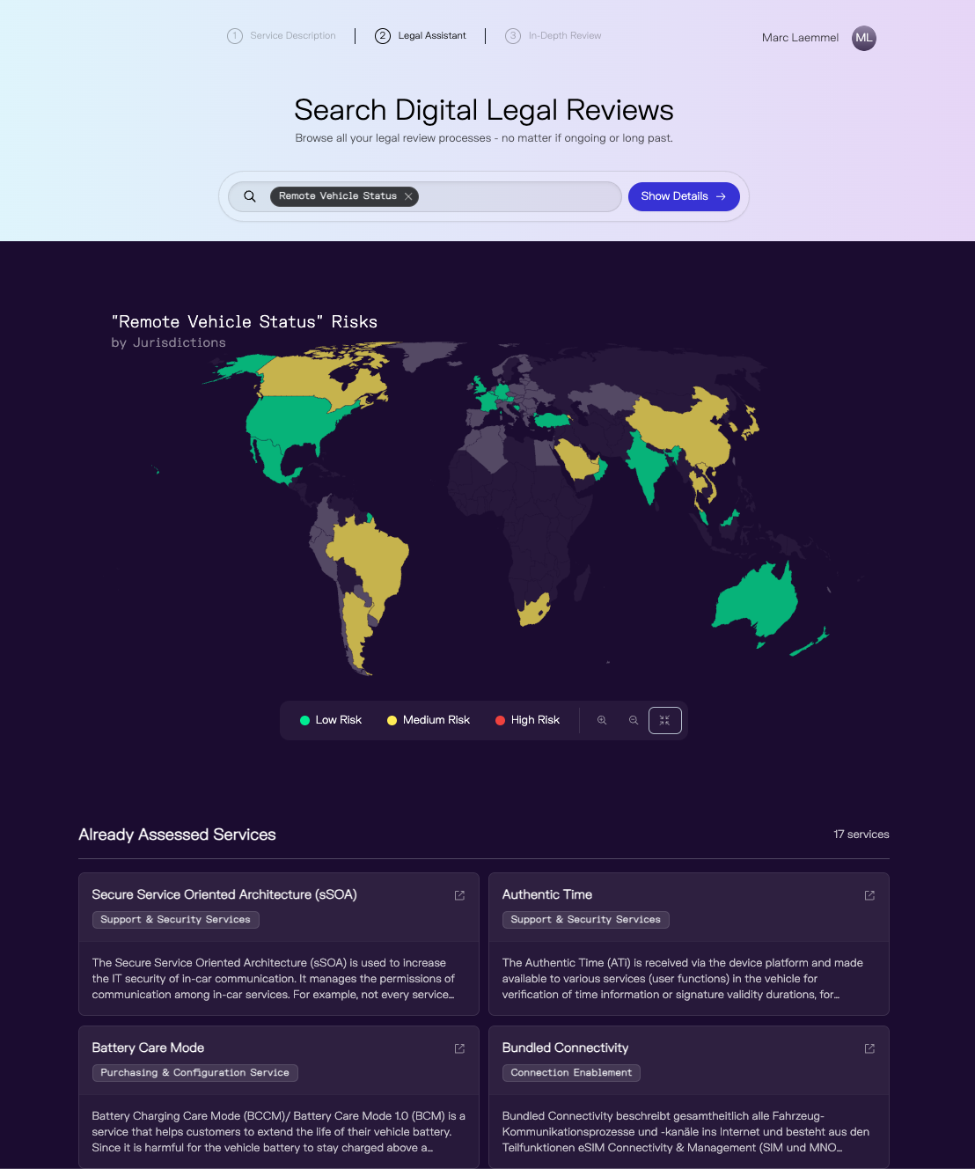

Automotive Industry Case | Our Solution Approach
LegalAI, an LLM-powered support of the legal compliance assessment of digital vehicle services
Selection of Vehicle Services
Global Risk Assessment
AI assesses the risks of a digital service and its functions Risks are assessed on the basis of country-specific legal requirements A list of measures addresses open questions and (potential) risks and thus supports Product Owners in making their service legally compliant
Risk Score
A generative-AI-enabled solution supports the legal risk assessment of all digital vehicle services on a digital platform.
Software development and risk assessment processes are streamlined. Developers receive a pre-assessment at a click of a button, legal experts can focus on high-risk cases and specific requests based on the pre-assessment.

Slide 16
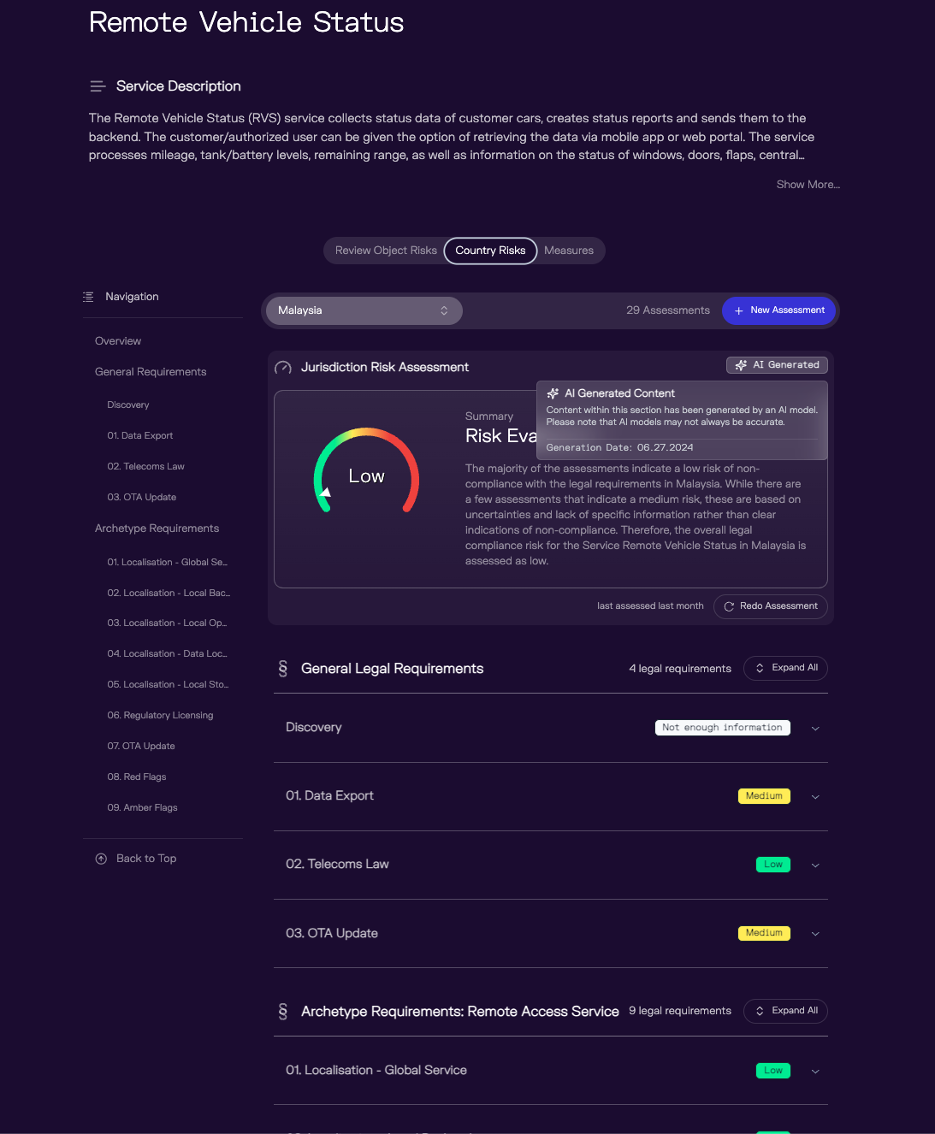

Automotive Industry Case | Project Challenges
Service Description
Transparency and quality assurance for generative AI in productive operation
Recommended Measures
Jurisdiction
Declaration of AI content
Risk Score and Summarization
Developing such a complex solution requires overcoming several challenges:
Generative AI is rarely used to automate complex risk assessments Together with the legal department and lawyers, we carried out extensive quality control to ensure that the AI's answers were correct For the correct assessment, the AI system must be able to access prepared contextual information The AI system is automatically evaluated based on various metrics; a confidence score is calculated for each AI response For each AI response, the user is presented with contextual information as sources to increase traceability and trust, but also to easily identify possible errors
Detailed Assessment

Slide 17







Automotive industry case | Client Benefits
This LegalAI solution unifies risk assessments, ensures global legal compliance, and substantially reduces costs as well as manual effort
Resolution Time
Direct initial assessment
Time-to-Market
Up to 60% increased time-to-market speed
Reduced Costs
Case specific cost reduction between 50% and 99%
Manual Effort
Experts have time to focu on high-risk-high-compelxity cases
Self- Service
Automated initial assessment with one click
Legal & dev alignment
Compliance during development
Notes:
Marc

Slide 18
Contact
18

Slide 19



Let‘s talk
Contact our experts we are available for ASML’s questions
Dr. Marc Lämmel Lead Data Scientist
marc.laemmel@eraneos.com
+49 151 21247 361
Dr. Jan Werth Lead Data Scientist
jan.werth@eraneos.com
+49 171 6415 807
Philipp Pytel Managing Director
philipp.pytel@eraneos.com
+491 515 2335 087

